Slide 1
DBMS MWB Project
Movie Recommendation System using Hadoop and Hive
Members: 1)Mehul Chaturvedi(20CS30032)
2)Mir Mohammad Wasif(20CS10035)
3)Bismay Parija(20CS10015)

Slide 2
Objectives
Build a scalable movie recommendation system
Create a recommendation engine that can handle large datasets.
Utilize Hadoop and Hive for big data processing
Leverage Hadoop's distributed storage and Hive's data warehousing capabilities.
Analyze MovieLens dataset for insights and recommendations
Extract valuable information and patterns from a widely-used dataset.

Slide 3
Methodology
Set up Hadoop and Hive environment
Configure and install the required software for data processing.
Import MovieLens dataset into HDFS
Transfer the dataset to Hadoop Distributed File System for easy access and manipulation.
Create Hive tables and load data
Define the schema and import data from HDFS into Hive tables.

Slide 4
Methodology
Implement SQL-like queries in Hive
Use Hive Query Language (HQL) to perform data analysis and manipulation.
Develop recommendation functions:
Top-rated movies
Identify movies with the highest average ratings.
Movies by genre
Filter movies based on a specific genre.
Similar movies
Find movies with similar genres to a given movie.
Preferences by demographics
Analyze user preferences based on demographic factors like age and occupation.

Slide 5
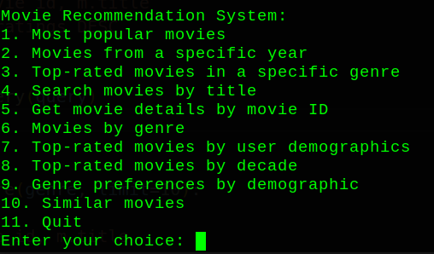
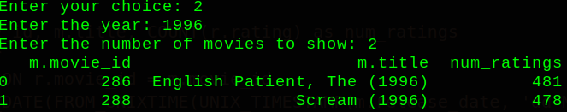
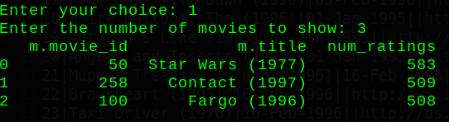
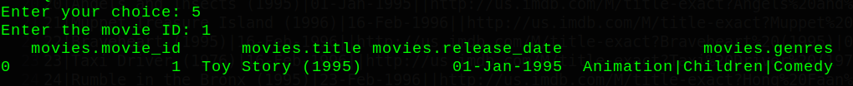
Results

Slide 6
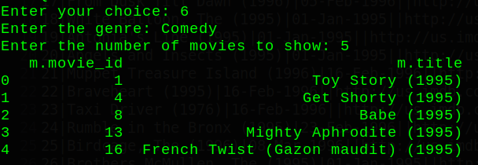
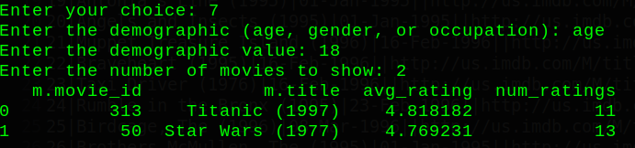
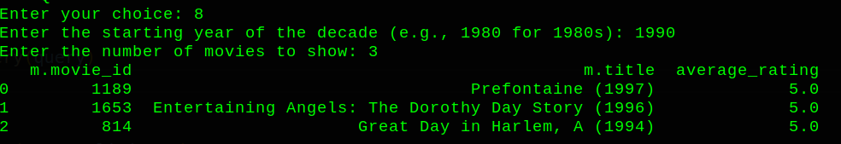
Results

Slide 7
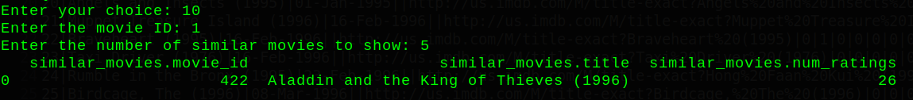
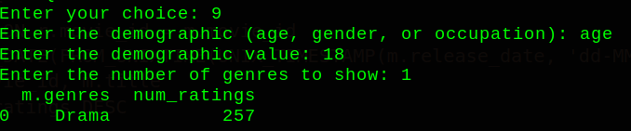

Results

Slide 8
References
Apache Hadoop: Official Documentation [Online Resource]
(https://hadoop.apache.org/docs/current/)
The official documentation for Apache Hadoop provides a wealth of information on Hadoop, HDFS, and related projects.
Apache Hive: Official Documentation [Online Resource]
(https://cwiki.apache.org/confluence/display/Hive/Home)
The official documentation for Apache Hive offers in-depth information on Hive features, functions, and best practices.
Tutorials Point Hive Installation
https://www.tutorialspoint.com/hive/hive_installation.htm#

